Slide 1
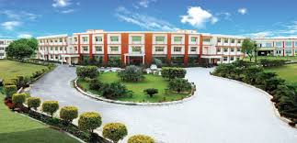
NEELKANTH INSTITUTE OF TECHNOLOGY
Dr. A.P.J. Abdul Kalam Technology University
DECEMBER , 2021

Slide 2
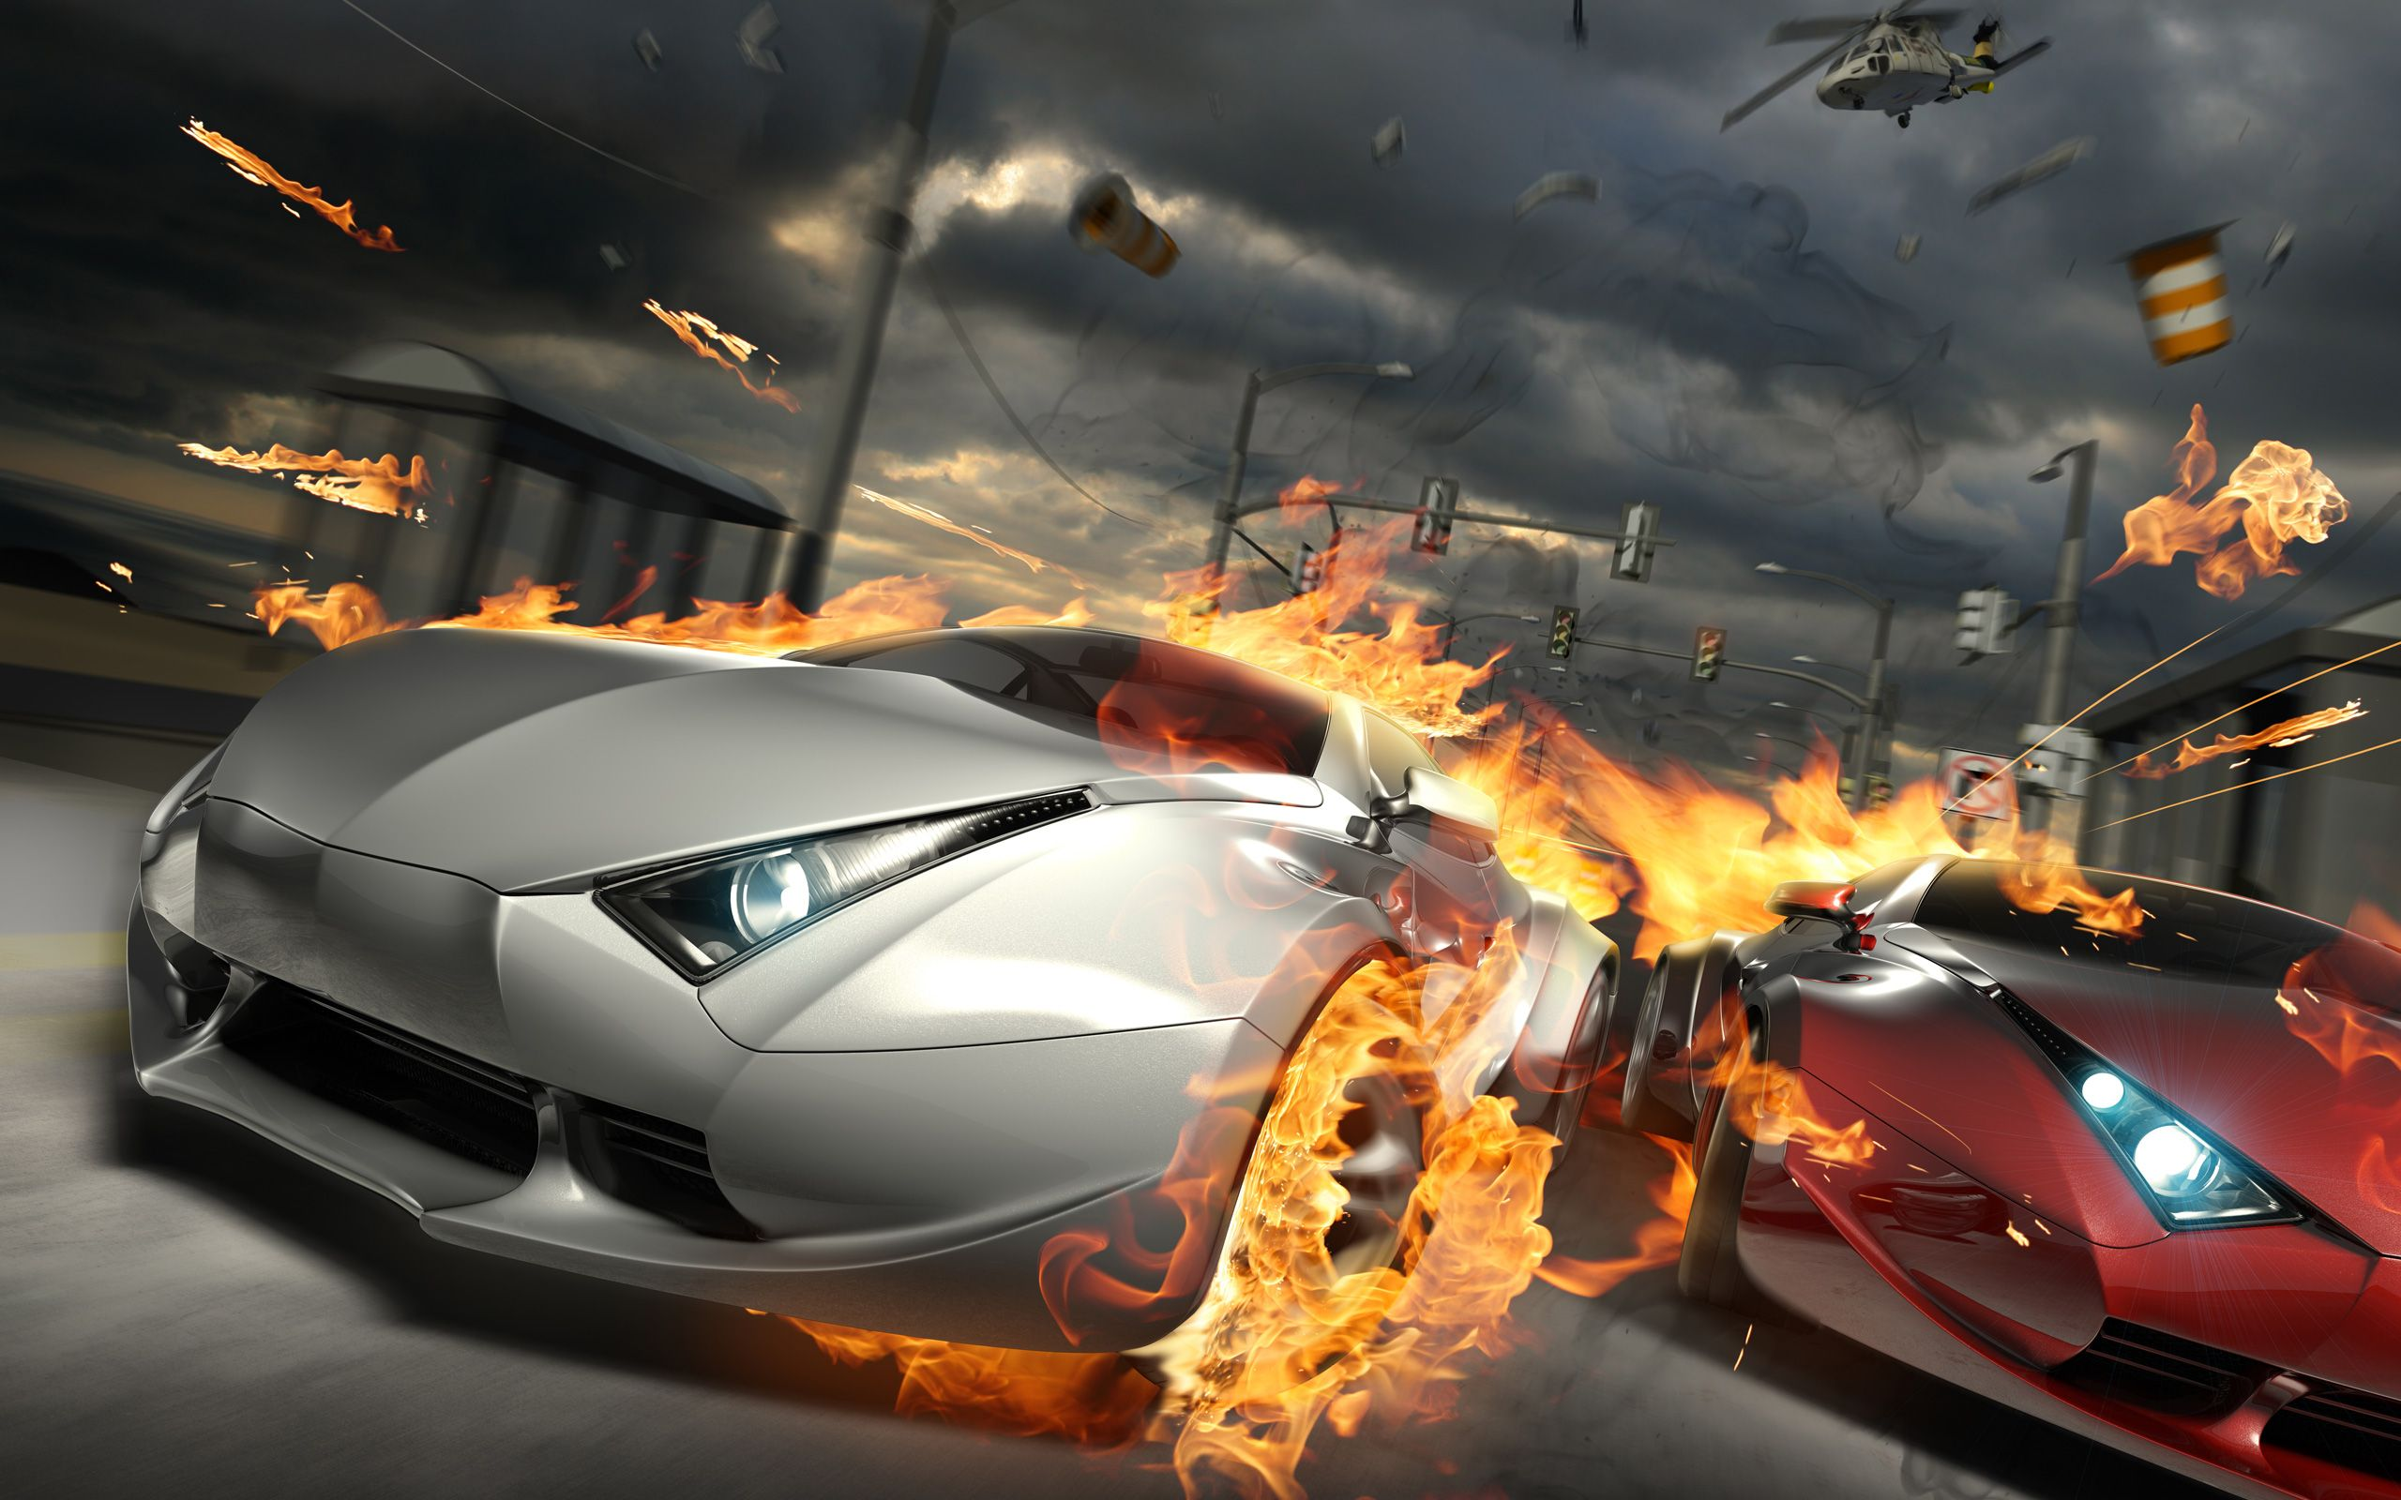
PROJECT ON “3D CAR RACING GAME”
BY
NITISH KUMAR (1837310033)

Slide 3

CONTENT:-
acknowledgement
ABSTRACT
INTRODUCTION
Project ANALYSIS
GAME DESIGN & IT’S FRAMEWORK
Games have become an integral part of everyday life
PROGRAMMING LANGUAGE
Sample User Run of Game System
GAME MECHANICS
MPLEMENTATION OF PROGRAM
The Background Generation Algorithm
RECOMMENDATIONS
Conclusion
feedback & suggestion

Slide 4

ACKNOWLEDGEMENT
Source : 3D CAR RACING GAME
HOD SIR:-PROF. PRABHAT GUPTA SIR
Advisor:-PROF. PRABHAT GUPTA SIR
Speaker:- nitISH kumar

Slide 5
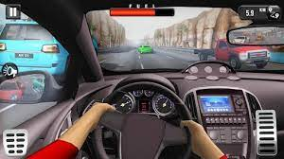
ABSTRACT
This bachelor thesis describes a case study , where we are focusing on developing a 3D Racing Car Game , using a process based on development ; an evolutionary development method.
The thesis will cover implementation of real-time graphics , physics engine, network support as well as background
At the end , our case study will show this development process was an appropriate choice for our game development project.

Slide 6
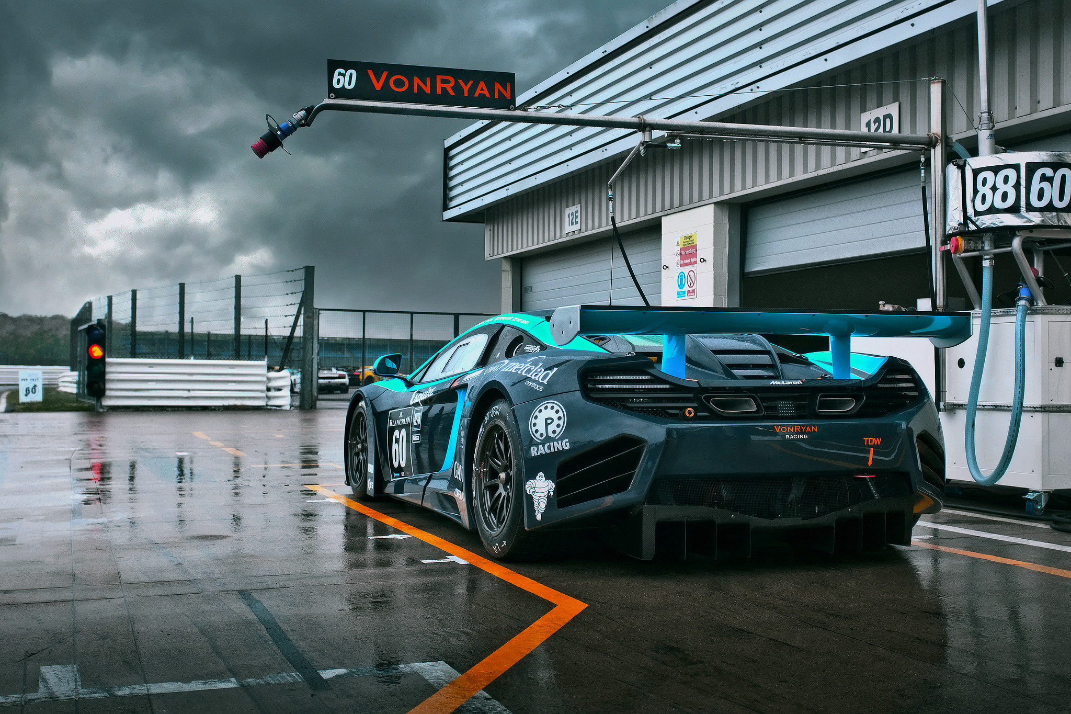
INTRODUCTION:-
1. This is a “3D Car Racing Game” based on the advance design of ‘HTML,CSS & JAVASCRIPT’
2. We try to implement a simple car game based on the basic design.
3. In the fast growing field of software engineering and development and even more rapidly growing sector of game development the future is hard to predict.
4. Here we choose this type of work for doing better with development cycle, graphics, scripting, adopting technology and animation.

Slide 7

.Project Analysis
This game consists of three major modules.
First part is the Game Logic Generator which calculate the logic of this game, such as to detect bumps to obstacle, speed control based on keyboard input, opponents control and road generation, and this module is based on software.
The second part is the Screen Rendering Module, we adopt the Sprite Graphics technique to decompose the display screen into 7 layers, which will be explained in derails in later section.
The last part is the Audio Module which generate the proper sound under the control of game logic. The overall design of the game is demonstrated. The following content of this paper explain each modules in details.

Slide 8
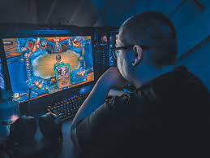
GAME DESIGN & IT’S FRAMEWORK
The thesis will cover implementation of real-time graphics, physics engine, network support, as well as sound effects and background music.
Desktop and Mobile HTML5 & CSS game framework and JavaScript. A fast, free and fun open source framework powered browser games.

Slide 9
Games have become an integral part of everyday life
Games have become an integral part of everyday life for many people. A traditional game often presents a situation where “players engage in an artificial conflict, defined by rules and results in a quantifiable outcome” . Such artificial conflicts are often represented as a puzzle or a challenge, and having the puzzle solved or the challenge resolved provides a real-world purpose to the game players. This type of games is sometimes referred to as “serious” games.
The game is a contemporary video game, and its objective is to offer the player a challenging and enjoyable experience in a car race against a game-controlled car. Although the player’s goal within the game is to win the race against the game-controlled car, the AI techniques adopted in the game are primarily designed to give the player an enjoyable time racing his or her car. In other words, the objective of winning by either side is not given the highest priority.

Slide 10


Programming Languages
JavaScript is the primary programming language used for writing the scripts to control the behaviours of objects in this game.

Slide 11
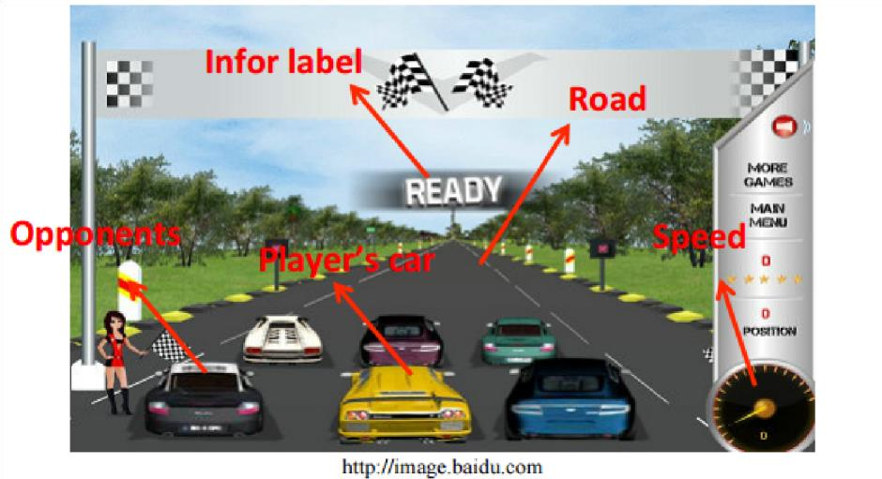
Sample User Run of Game System
For this Car Racing Game, we would like to accomplish a video game imitating the existing game showed as Figure 1 with a projective view. The theme of our game is to compete with the other 5 opponents that are controlled by computer in a racing tournament

Slide 12

Game Mechanics:
The player can either choose to play with a keyboard or a wired controller or with the touch.
The player will use the controller of their choice to navigate through the race track while competing against the other.

Slide 13
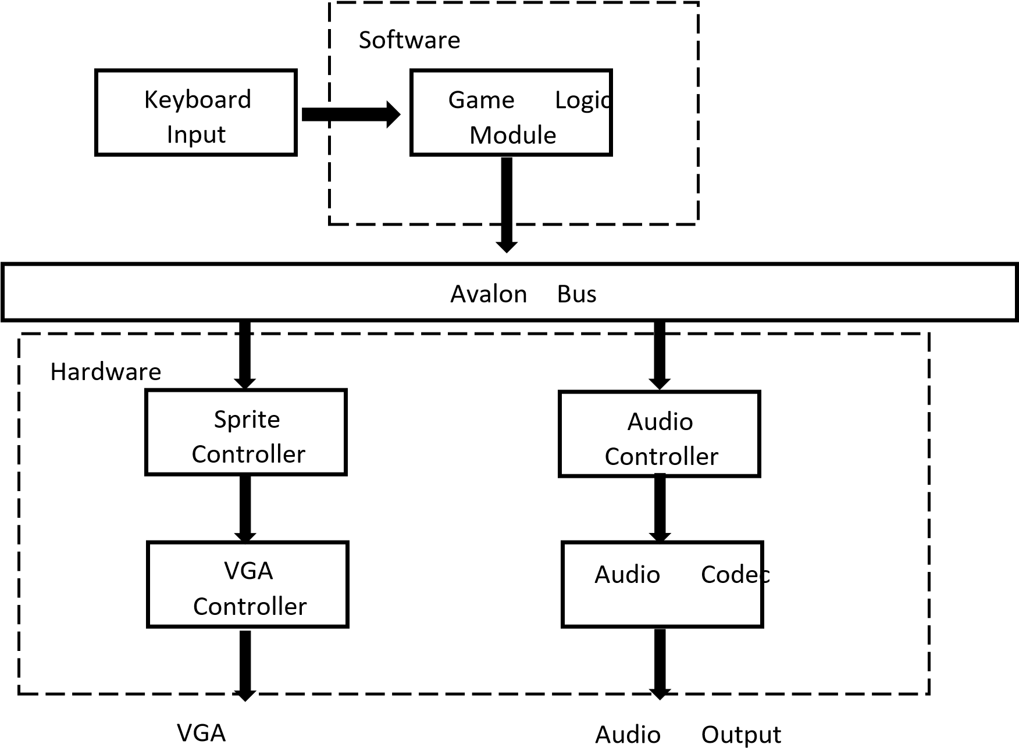
The overall design of Car Racing Game including Software and Hardware.

Slide 14



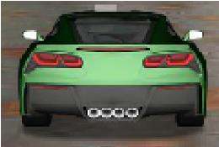
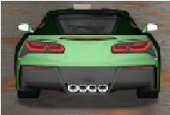
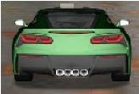



Sprite Control Module
the Sprite Control Module’s job is to generate the 32*32, 48*48, 64*64 pixels RGB value for VGA Controller based on the control signal provided by the Game Logic Module. The Game Logic Module provides the X and Y coordinates for different objects, like trees, clouds, cars, scores, speed

Slide 15
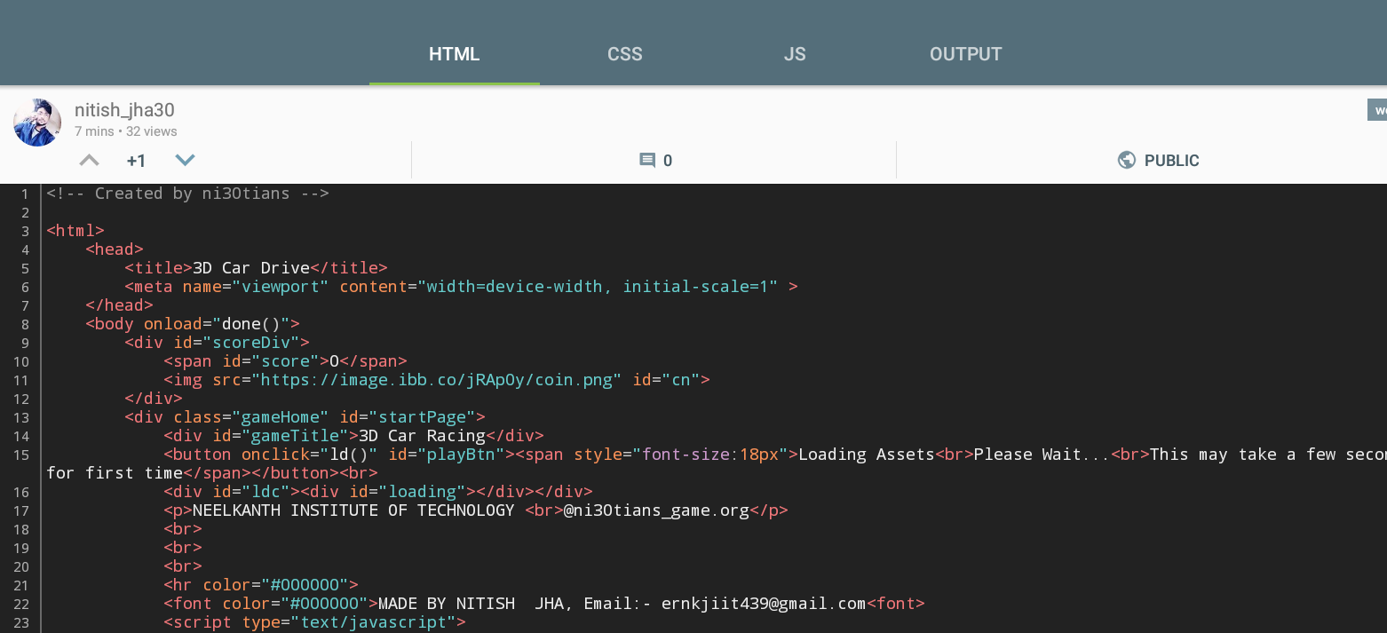
IMPLEMENTATION OF HTML

Slide 16
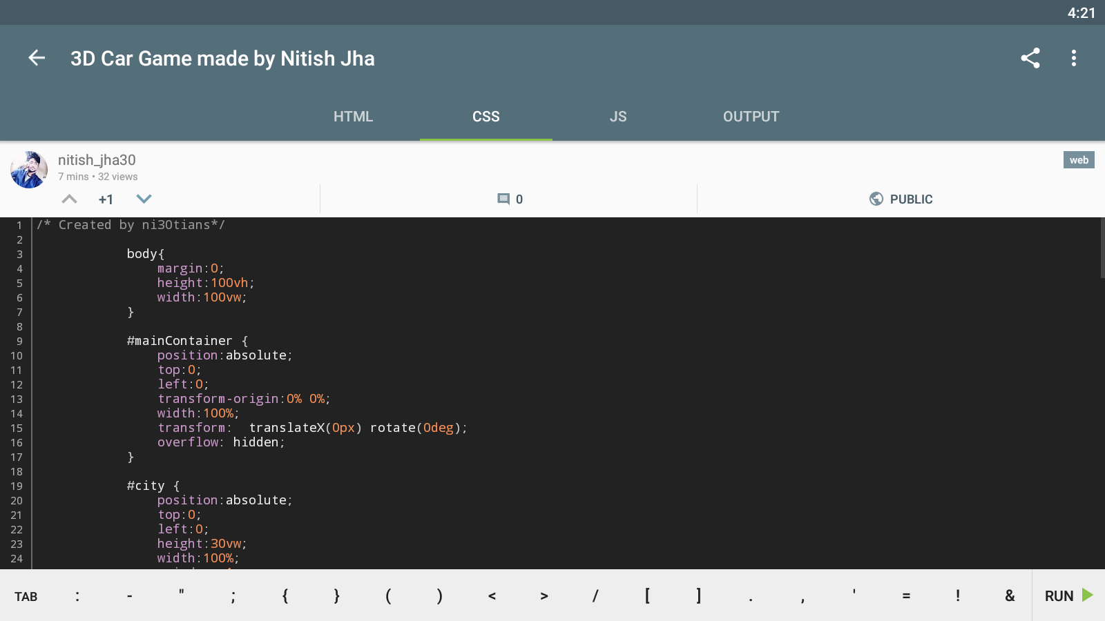
IMPLEMENTATION Of CSS

Slide 17
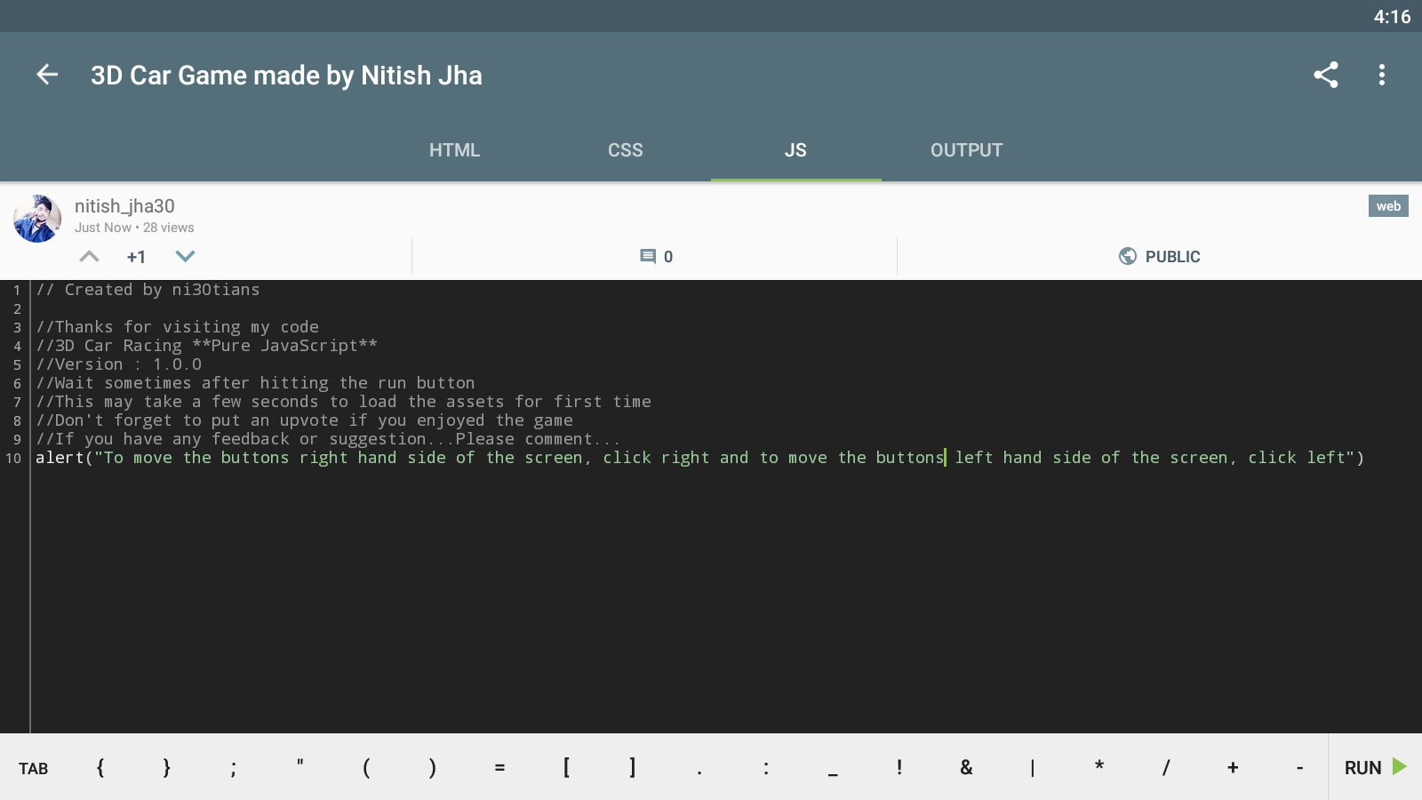
IMPLEMENTATION Of JS

Slide 18
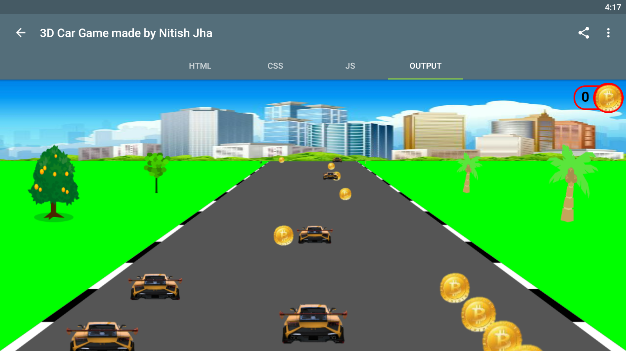
A SNAPSHOT OF GAME

Slide 19
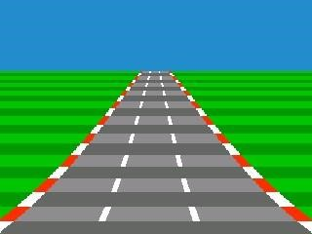










The Background Generation Algorithm
In our design, the background containing road, land and sky is generated different from other Sprites, because it can’t be simply be pasted to the screen according to X and Y coordinates of Sprites. Therefore we design a special module for Background Generation. The background is showed in Figure
A(X,Y)
.
B
C
.
.
Figure 5 The Background Sprite

Slide 20

. Recommendations
Suggested Team: Myself. I will be doing all the parts of the project.
Estimated Budget: As of right now, there’s not going to be any spending because all the software I’m going to be using are free to student and is easily accessible.
Rough Timeline: 2 month period
Vehicle Modeling ~ 1
Vehicle Components ~ 1 week
Track Components ~ 2 weeks
Rendering ~ 1 week
Creating Tracks in Unity ~ 1 week
Coding & testing ~ 1 month.

Slide 21

Conclusion
This is a gaming program that can help the player to enjoy and entertain. It reduces stress. It helps to develop the mental power.
The game is mostly love by the children

Slide 22

Created by ni30tians Thanks for visiting my code”3D Car Racing Game” which is Pure JavaScript //Version 1.0.0 Wait sometimes after hitting the run button. This may take a few seconds to load the assets for first time Don't forget to put an upvote if you enjoyed the game If you have any feedback or Suggestion...Please comment...
Any feedback & suggestion

Slide 23
THANK YOU….

